Slide 1



CSE Major Sharing
Guochao Xie 谢国超
The Chinese University of Hong Kong, Shenzhen
May
2020
About Me
PPT link

Slide 2

Self Introduction
Class of 2017, CUHK(SZ)
Major: Computer Science of Engineering
GPA: 3.8+
Research Area: System
Co-Founder of Polaris Studio (北极星工作室)
USTF of ERG3010, Fall 2019 and CSC1002 Spring 2020
Summer: University of California, Berkeley, 2019.
More Information:
Personal Homepage: xieguochao.com
About Me
PPT link

Slide 3

WHY CSE?
Interest-Oriented or Interests-Oriented?
About Me
PPT link

Slide 4
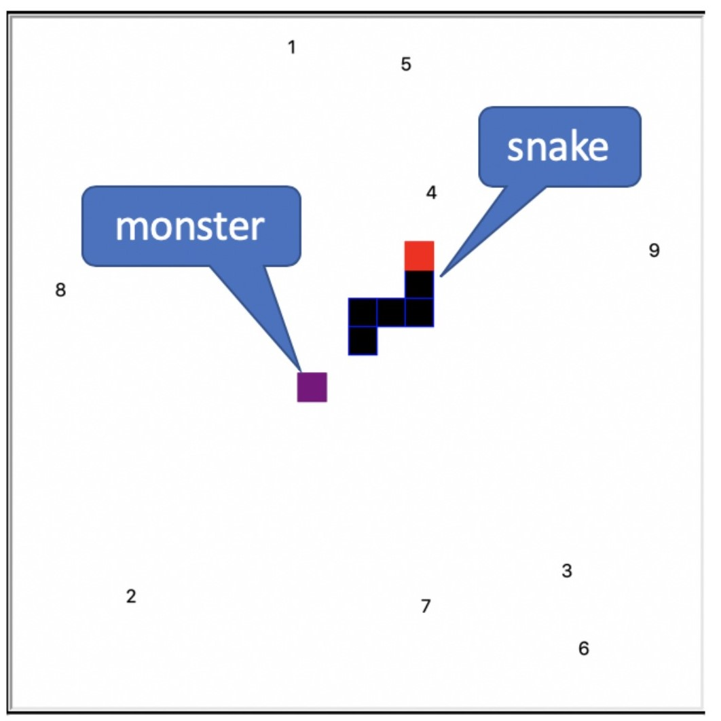
Interest-Oriented
Playing games? Or Building games?
Reference: Kinley, CSC1002 Assignment 2,
Spring 2020.

Slide 5
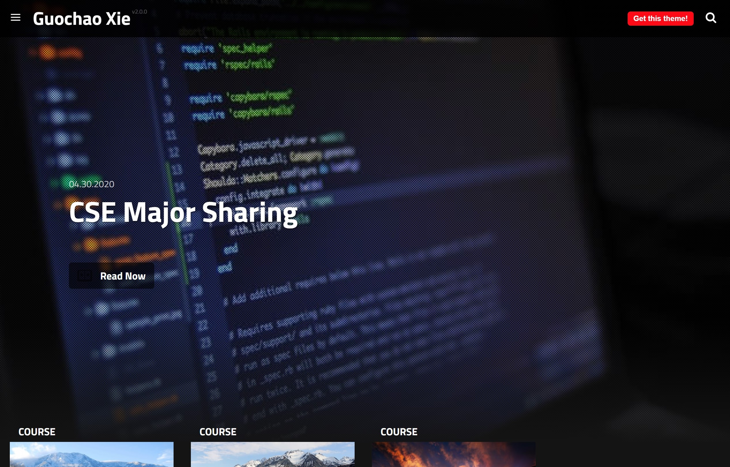

Interest-Oriented
Write websites?
Reference: Personal Blog
https://blog.xieguochao.com/

Slide 6
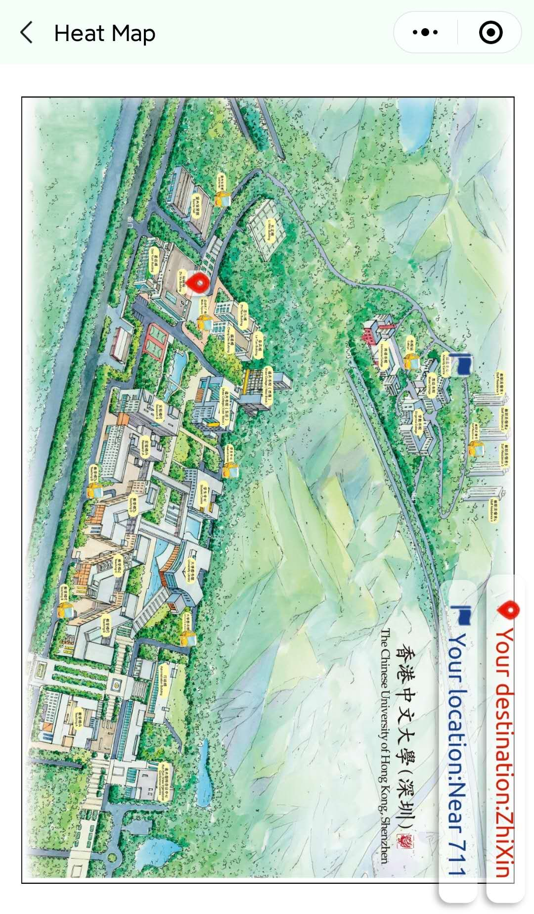
Interest-Oriented
Build Mini App?
Reference: CUHK(SZ) Campus Heatmap
(Search: CUHKSZHEATMAP on WeChat),
Summer 2018.

Slide 7
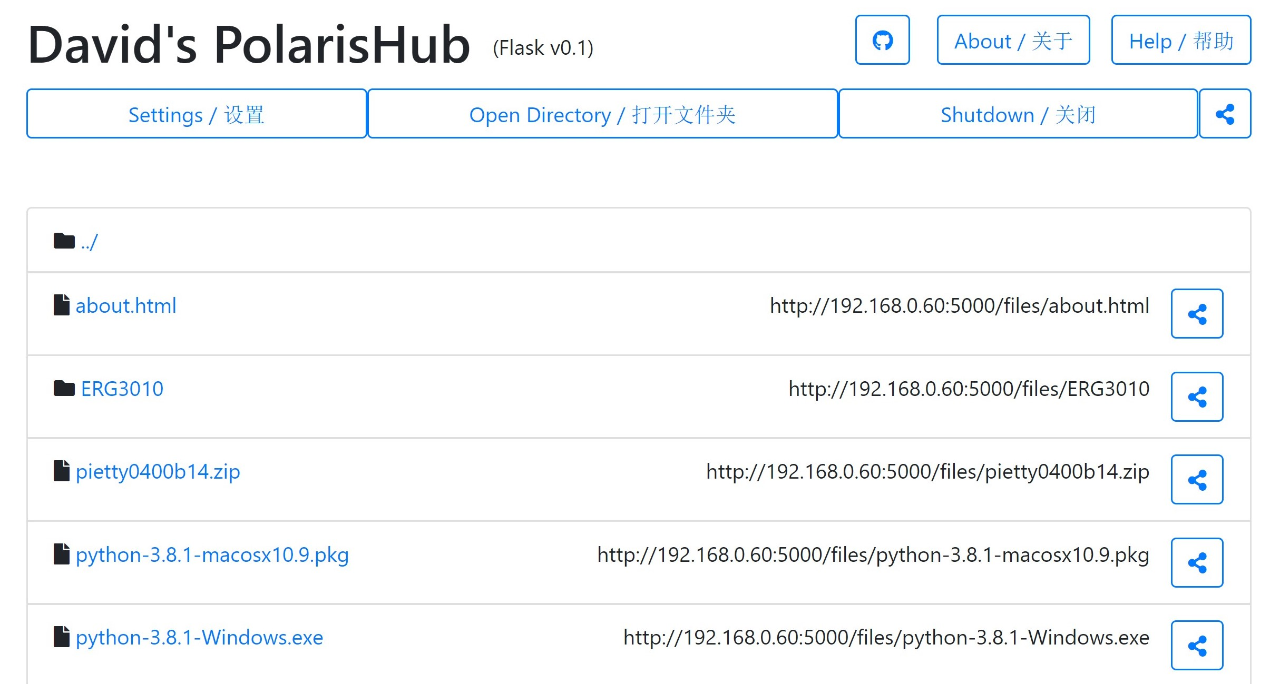
Interest-Oriented
Build Useful Tools?
Reference: PolarisHub (Open-Source on GitHub)
https://github.com/XieGuochao/polarishub_flask

Slide 8

Interest-Oriented
ML & AI?
PS: I am one of the contributor of the book
《动手学深度学习》 (https://github.com/d2l-ai/d2l-zh),
fixing a bug.

Slide 9
Interest-Oriented
More?
If you are interested in everything that can be solved by
hardware, software, and the Internet, choose CSE!

Slide 10
Interests-Oriented
Well-Paid?
996?
You may refer to our outstanding graduates:
Xiaoxing Ye
Yifan Lan

Slide 11
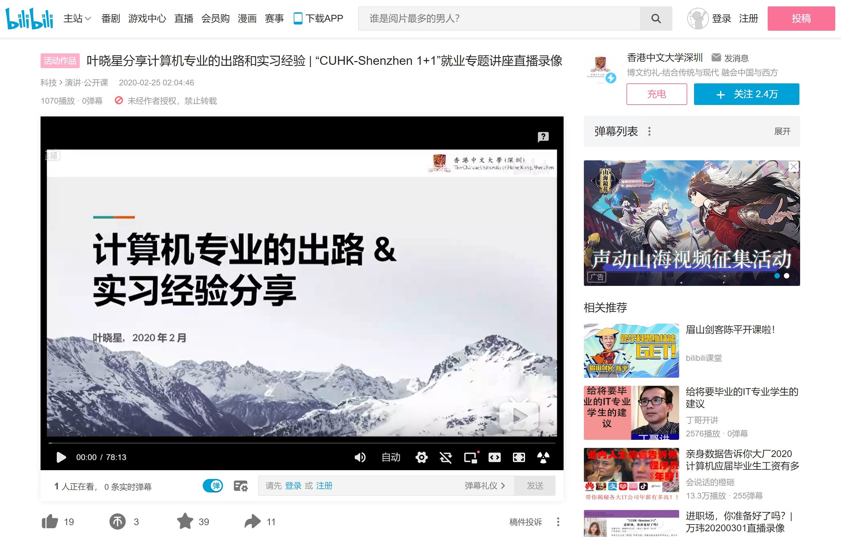
Interests-Oriented
Working in Microsoft
https://www.bilibili.com/video/BV1r7411u7h5

Slide 12
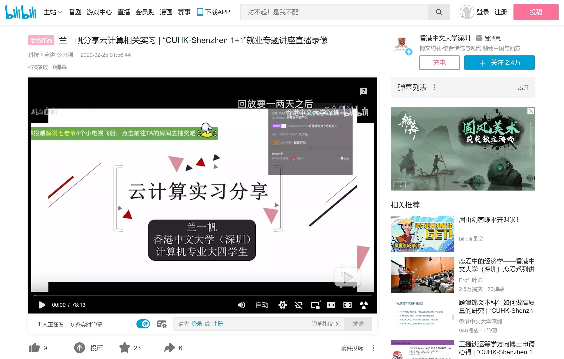
Interests-Oriented
Working in Amazon Web Services
https://www.bilibili.com/video/BV1B7411u7QT

Slide 13
CSE Courses
About Me
PPT link

Slide 14
CSE Courses
- Year 1
- Python: CSC1001, CSC1002
- Year 2
- 1st Term:
- Discrete Math: CSC3001
- Digital and Logic Systems: EIE2050
- 2nd Term:
- C++: CSC3002
- Computer Architecture: CSC3050
- Year 3:
- 1st Term:
- Data Structures: CSC3100
- Operating Systems: CSC3150
- 2nd Term:
- Database: CSC3170
- Software Engineering: CSC4001
- Year 4:
- Distributed and Parallel Computing: CSC4005

Slide 15

CSE Requires Self-Learning!
Will the university teach these?
Building website? (You may learn in 1 or 2 tutorials ...)
Building APPs? (NO!)
Writing reports? (Almost no...)
About Me
PPT link

Slide 16
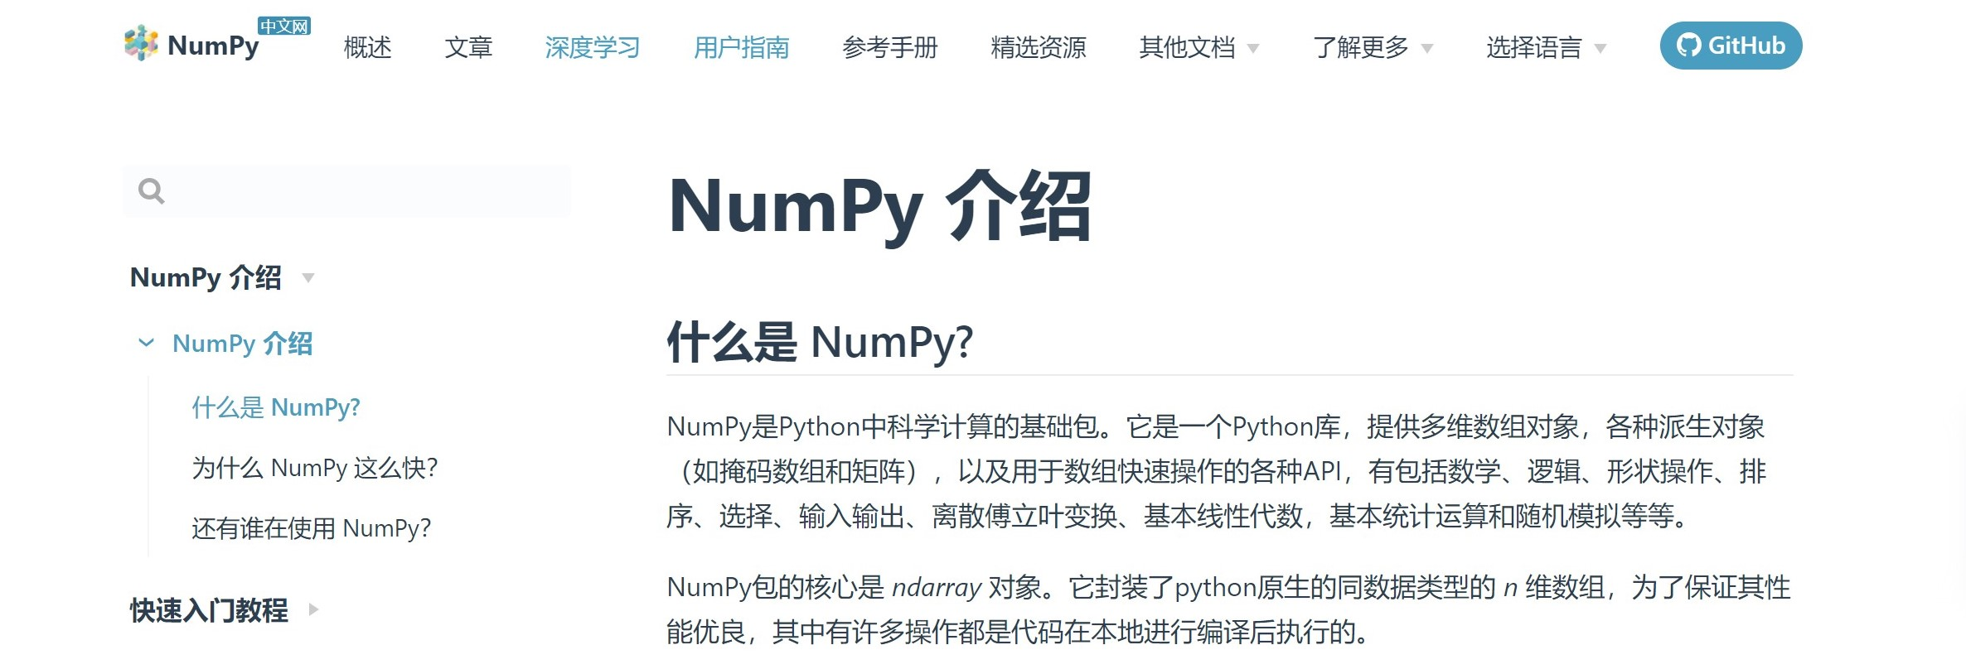
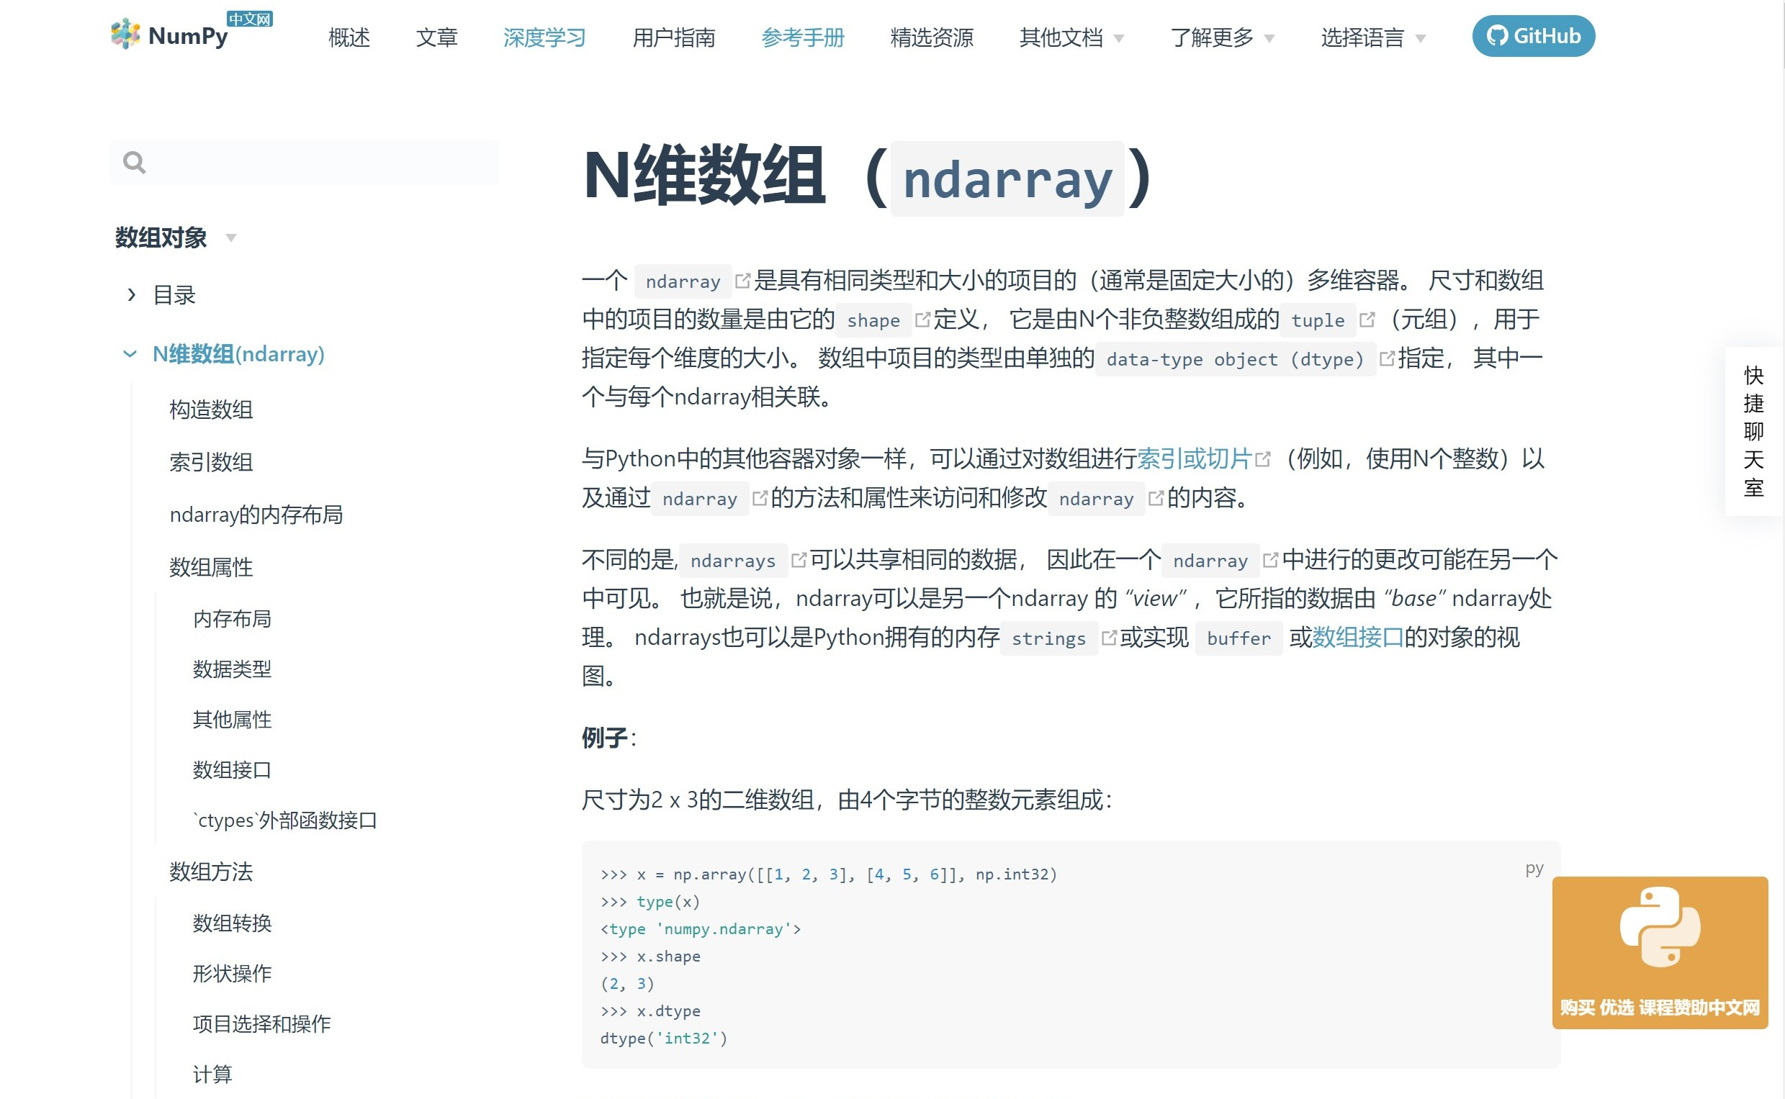
Learn by reading documents

Slide 17

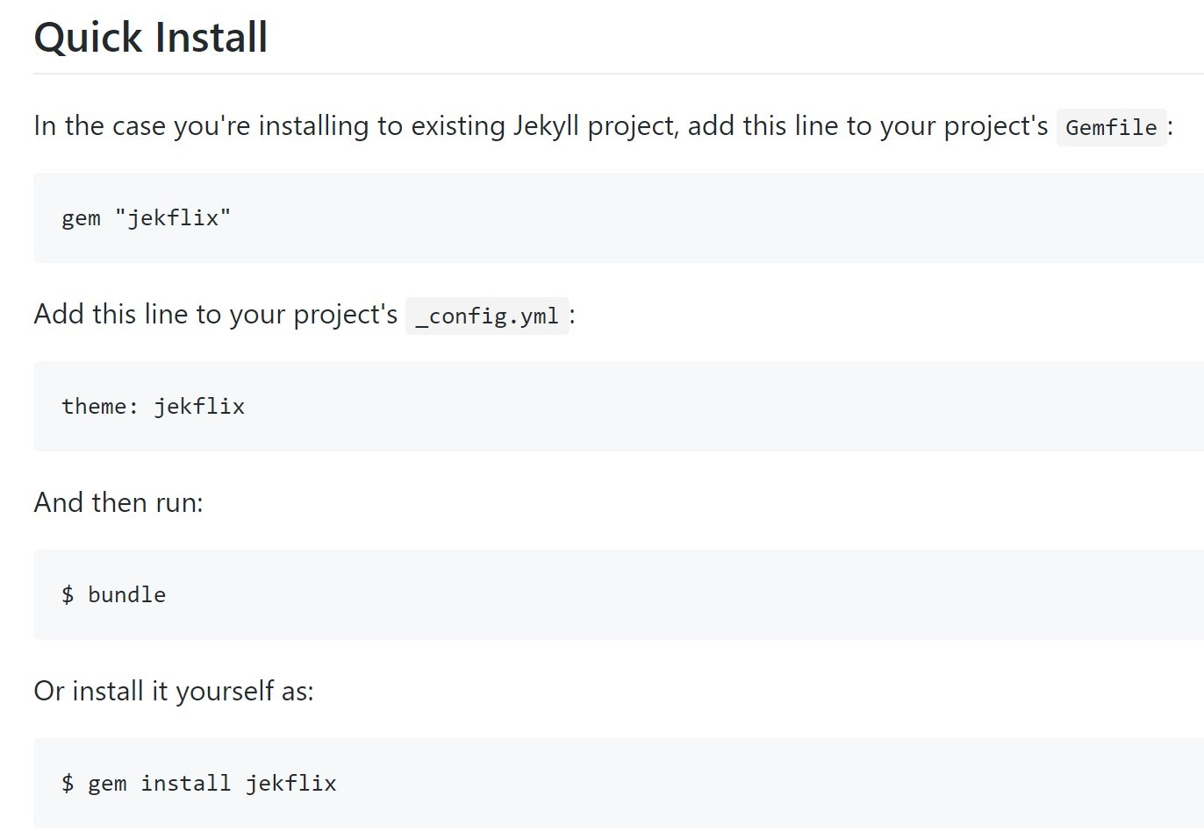
Learn by following instructions
+

Slide 18
Learn by following instructions
Then, build your own blog?

Slide 19

Life of Being Patient and Debugging

Slide 20
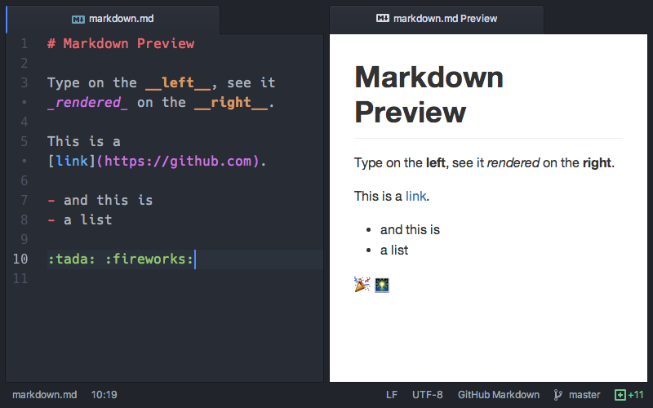
Free to Learn Cool Things!
Writing in Markdown:

Slide 21
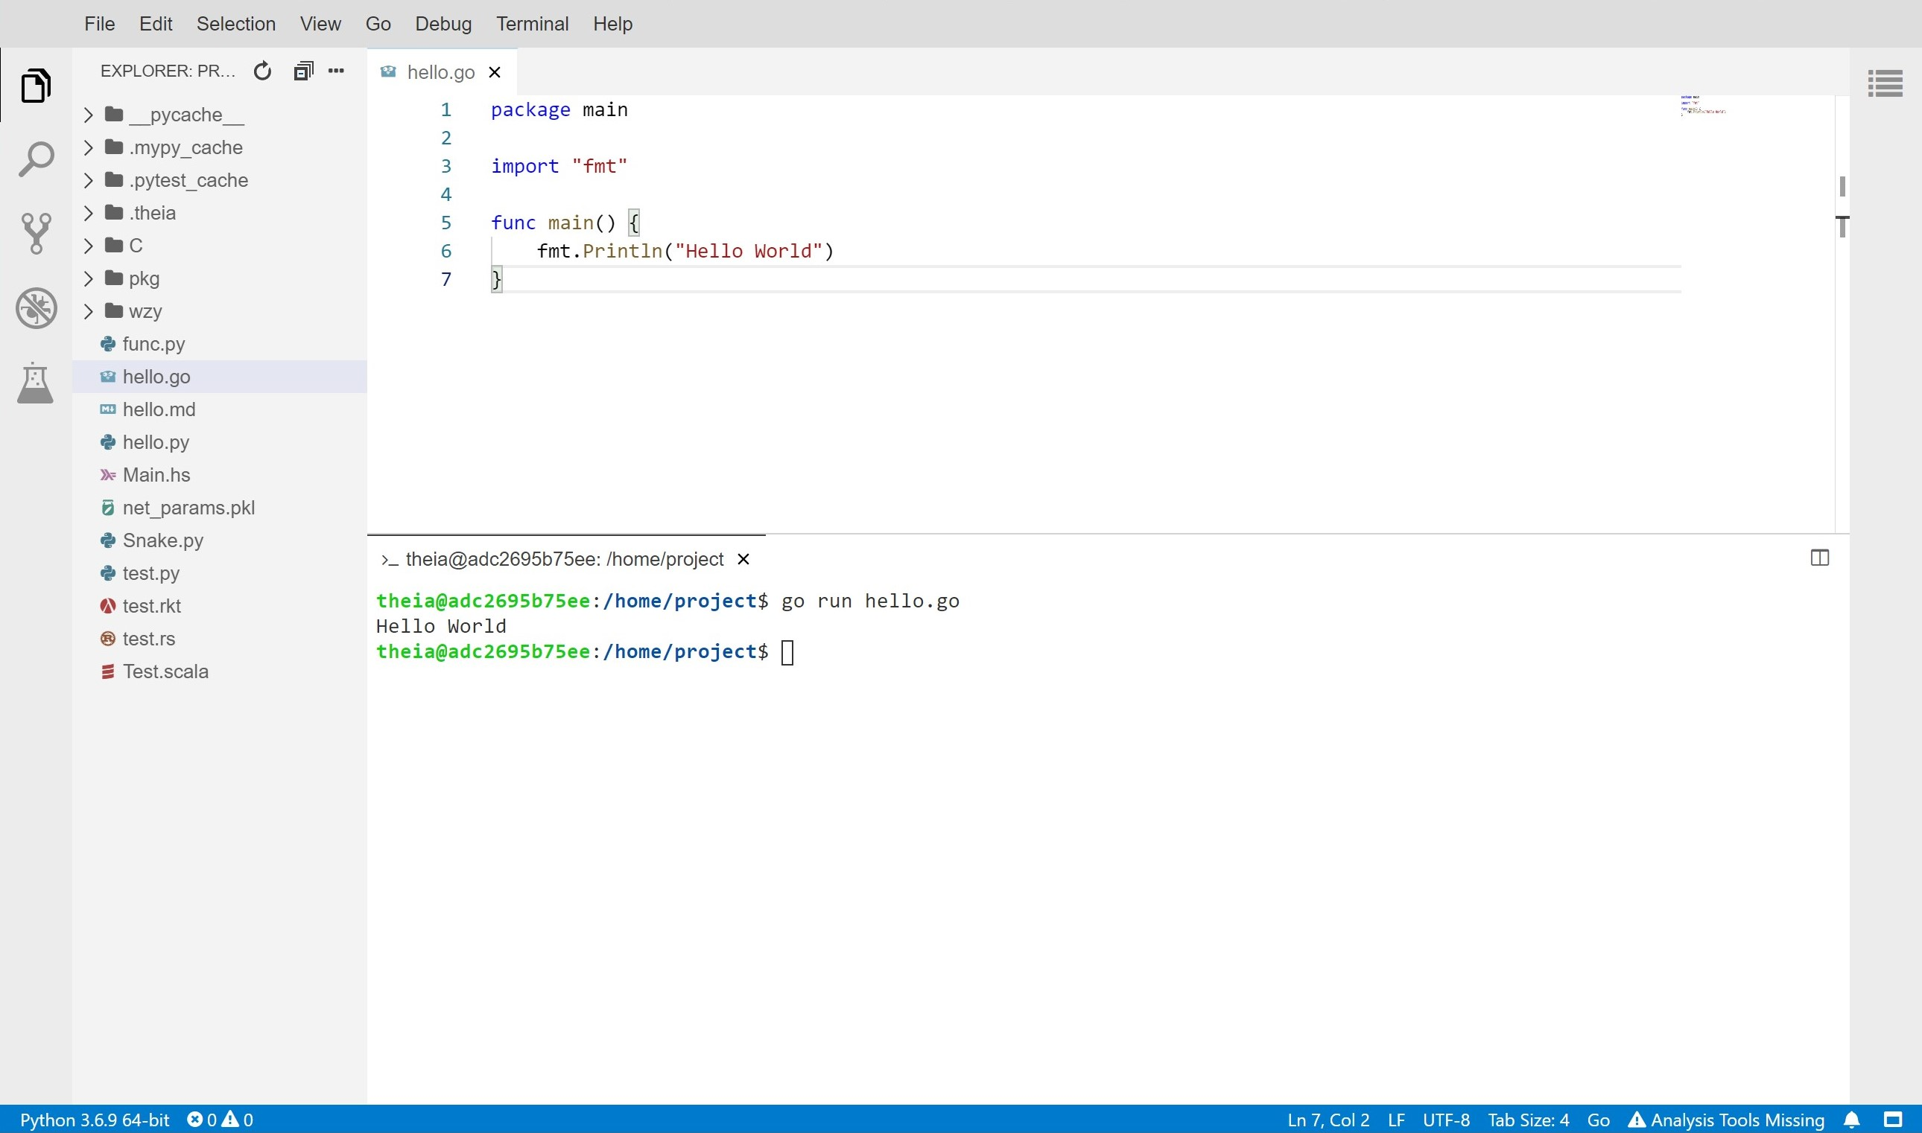
Free to Learn Cool Things!
Running VSCode on website
https://workspace.xieguochao.com/

Slide 22
Conclusion
Choose CSE and be a cool guy!

Slide 23
Advertisement
I will be USTF of CSC3100:
data structures this summer.
Welcome to ask me questions!

Slide 24

THANK YOU!
Guochao Xie 谢国超
The Chinese University of Hong Kong, Shenzhen
Website
https://xieguochao.com/
About Me
PPT link

